Slide 1


Pennsylvania Spatial data access
http://www.pasda.psu.edu
PA Geospatial Coordinating Board September 2016

Slide 2
Overview
About PASDA
Purpose
Stats
PASDA Users
PASDA Services
Online Mapping
Open data
Preservation
Outreach & User Support

Slide 3
Question
How many of you have used PASDA before?
What do you use it for?
What data do you use most often?

Slide 4
About pasda
Pennsylvania Spatial Data Access (PASDA) is Pennsylvania's official public access geospatial information clearinghouse. PASDA was developed in 1996 by the Pennsylvania State University and has served as the clearinghouse for Pennsylvania for over twenty years.
PASDA is a cooperative project of the Governor's Office of Administration, Office for Information Technology, and Penn State Institutes of Energy and the Environment of the Pennsylvania State University.
Funding and support is provided by the Pennsylvania Office for Information Technology.
Penn State provides significant contributions to PASDA including system administration support and infrastructure from the Institute for CyberScience, and the College of Earth and Mineral Sciences.

Slide 5
Purpose
PASDA was developed as a service to the citizens of the Commonwealth of Pennsylvania.
The purpose of PASDA is to serve as the Commonwealth's comprehensive and coordinated open geospatial data portal that provides free public access to geospatial data and information by, for, and about the Commonwealth of Pennsylvania.
PASDA provides access to credible and authoritative source data.
Maintaining PASDA as a coordinated and comprehensive portal eliminates the creation of Data Silos that can frustrate and complicate public access to data.
One of the primary purposes of PASDA is to facilitate data sharing in a streamlined environment, making the process fast and easy for data sharing stakeholders.
Any state, local, or federal government, non governmental agency, or academic institution can freely share its geospatial data through PASDA.
PASDA serves as Pennsylvania’s node on the NSDI and works at the national level to ensure that we meet national and international standards for metadata and data delivery.

Slide 6
Stats
PASDA stores more than 85 Terabytes of data and provides access to more than 450,000 data sets.
  (Note: This does not include the Statewide Imagery Cache (this data is only available for use via a map service or for viewing via the PA Imagery Navigator) which consists of more than1.2 million images.
Overview FY 2015/2016 Statistics:
  PASDA Hits: 91,169,041
  Page Views: 49,684,434
  PASDA Unique Visitors: 1,035,588
  Datasets Downloaded: 2,455,977
  Map Services Requested (APIs, KMLs, WMS, REST): 70,899,511
  Pennsylvania Imagery Navigator: 5,456,183

Slide 7
PASDA Users
State Agencies
Local Governments—Municipal, County, Regional
Federal Agencies—EPA, FEMA, US Military, Homeland Security, National Weather Service, Army Corps,Transportation,…
Emergency Responders, Police Departments
Non Profit Organizations
Conservation Districts
Academic Institutions
Business and Industry: Engineering, Surveying, Utilities, Engineers, Architects, Developers, Environmental Management, Real Estate, Transportation, Geospatial…
K-12 Schools
Pennsylvania Citizens!

Slide 8
Pasda Today: Services
Data Storage
Data Management and Curation
Metadata Development
Metadata Training
Data Search and Retrieval
Data Download (in multiple formats)
Map Services/APIs/KMLs
Data Preservation and Archiving
Online Mapping Apps
  Data Previewer
  PA Imagery Navigator
  PA Atlas
  PA Mine Map Atlas
  Data Previewer
User Support
Offline Data Access
Integration with Additional Resources

Slide 9
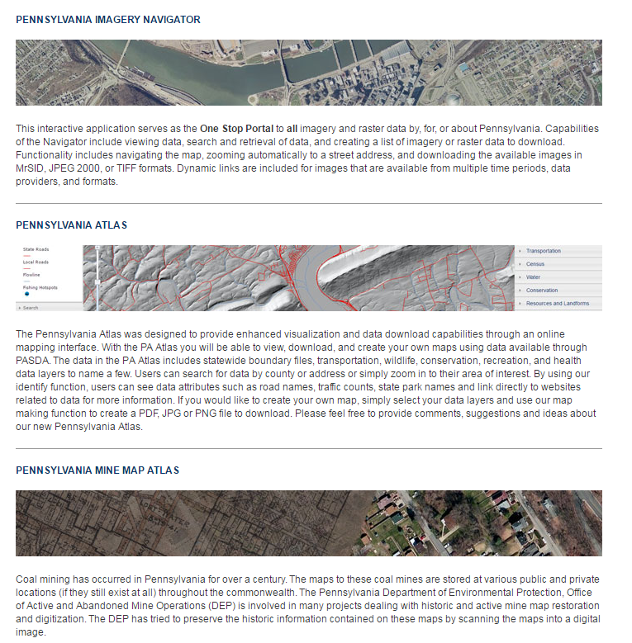
PASDA Online Mapping

Slide 10
Pennsylvania Imagery Navigator
The PA Imagery Navigator was created to provide easy access to the thousands of imagery, elevation, and LIDAR data sets available through PASDA.

Slide 11
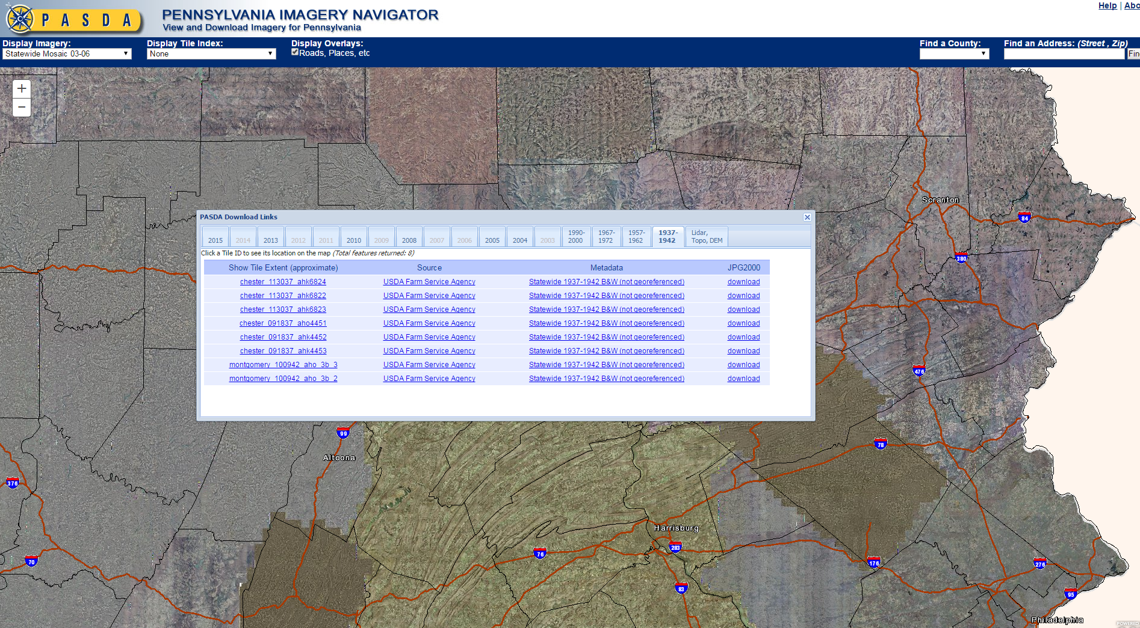
PA Imagery Navigator: Historic Imagery

Slide 12
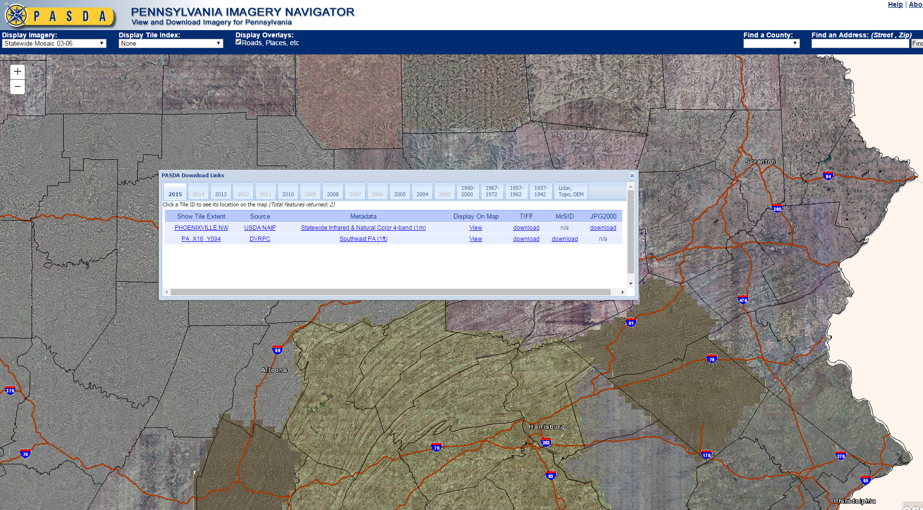
PA Imagery Navigator: Most recent Imagery

Slide 13
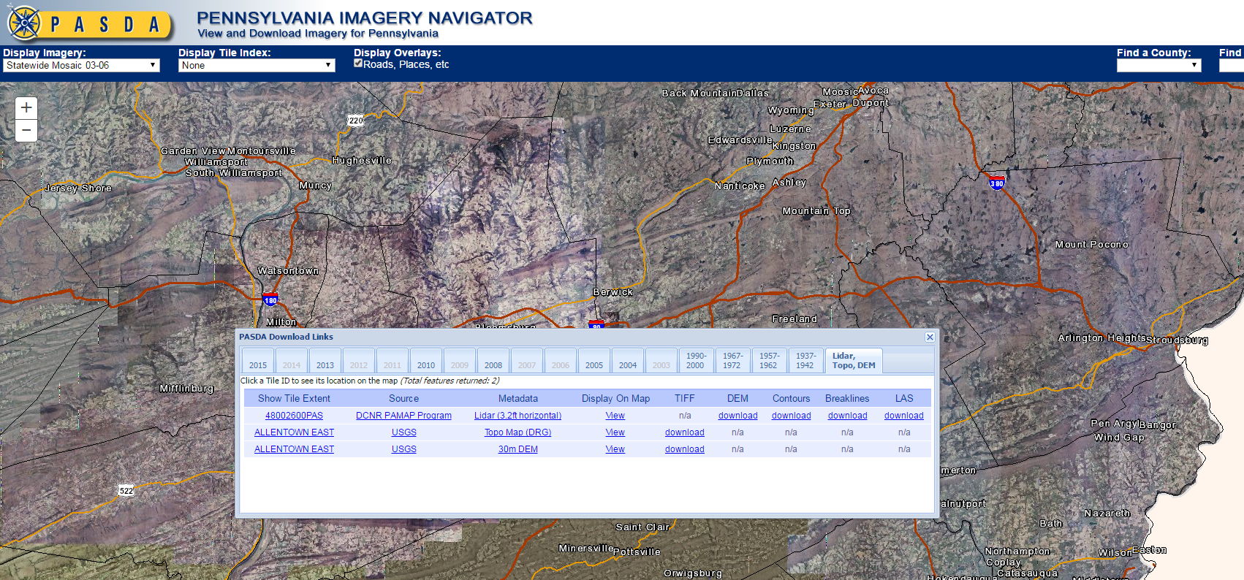
PA Imagery Navigator: LIDAR, Topos, DEms

Slide 14
Pennsylvania Atlas
The PA Atlas was created so users could easily visualize dozens of data sets available through PASDA without having to download each data set.

Slide 15
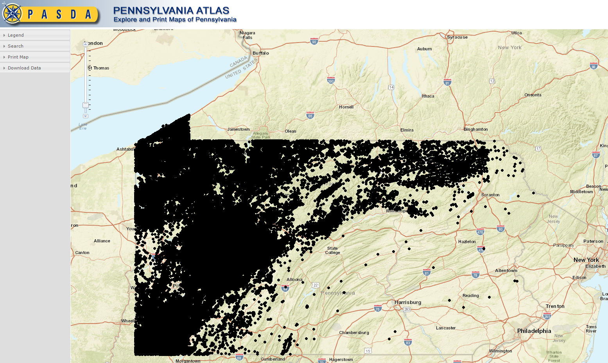
PA Atlas

Slide 16
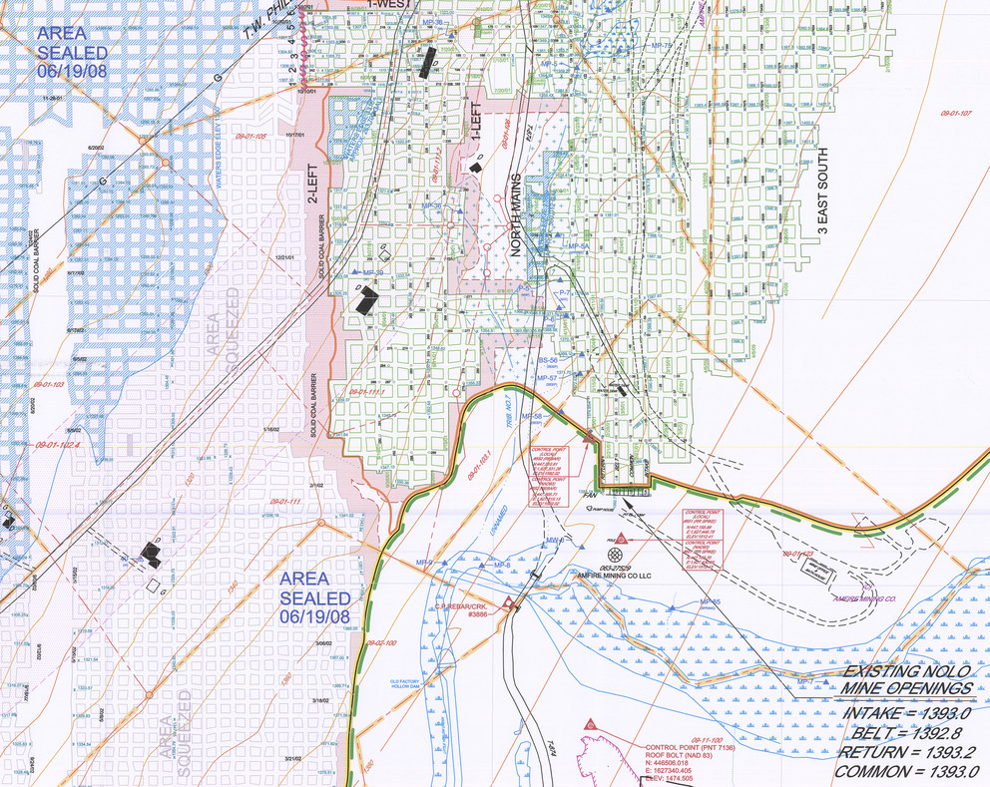
Pennsylvania Mine Map Atlas

Slide 17
Pennsylvania Mine Map Atlas
The Pennsylvania Mine Map Atlas is a new initiative of the Pennsylvania Department of Environmental Protection (DEP) and PASDA.
This application allows residents and stakeholders to see and download detailed underground mine maps that were once only available in hard copies.
It not only allows homeowners to view previously unavailable mine maps, but also allows them to see their home’s proximity to the nearest underground mine.

Slide 18
Pennsylvania Mine Map Atlas
The impetus for the project began almost 10 years ago when the DEP approached PASDA about the possibility of providing public access to their underground mine maps. This was, in part, a result of the Quecreek Mine Rescue that occurred in Somerset County.
On July 24, 2002, 18 miners accidentally tunneled into an adjacent abandoned mine and nine of them became trapped by the millions of gallons of water that proceeded to rush in. After 78 hours of desperate escape attempts and hopeless notes scrawled for loved ones, the miners were finally found and pulled to safety.
The accident led to a strong push at the DEP to provide access to the underground mine maps, which were primarily in paper.
By September 2012, the DEP had scanned thousands of these maps into digital form and were ready to provide them to PASDA.

Slide 19
Mine Map Data
By May 2013 the California, Pa., office of the DEP provided PASDA with the first 15,000 digital maps, and PASDA began providing public access to downloadable versions of the maps.
This project, which is ongoing, will eventually provide access to more than100,000 underground mine maps.

Slide 20
PHUMMIS Integration
In addition, the PA Mine Map Atlas has been integrated into the Pennsylvania Historic Underground Mine Map Information System—PHUMMIS at the PA Department of Environmental Protection.
This database contains information relevant to past and present underground mining within the Commonwealth of Pennsylvania, including, but not limited to, maps, indices, locations of mines, and other pertinent data contained in various collections held or obtained by the Pennsylvania Department of Environmental Protection’s Office of Active and Abandoned Mine Operations.

Slide 21
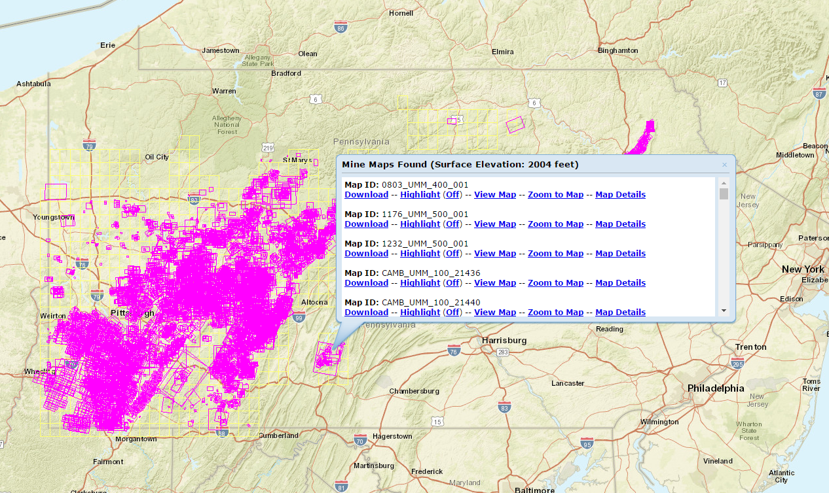
PA Mine Map Atlas

Slide 22
PASDA & Open Data
PASDA has provided free access to data for more than 20 years.
PASDA has provided access to open source data formats (WMS services, APIs, GeoJSON)
Data on PASDA is discoverable through multiple venues: Google, Data.gov, ESRIs ArcGIS Online, and more!

Slide 23
Preservation & Persistence
Data is an asset that belongs to the citizens of Pennsylvania.
It is important that we not only provide access to data today but also that we manage it and preserve it so that it is available to future generations of Pennsylvanians.
Two issues that are highly significant are preservation of data and persistence of location. The Library of Congress and Federal Geographic Data Committee have been working on this issue for several years through a committee dedicated to identifying and reporting out on data preservation.
PASDA is a member of this committee and contributed to the recommendations and report.
PASDA is committed to long term preservation and access to historic data sets for Pennsylvania.
PASDA currently has a two level approach.

Slide 24
Preservation & Persistence
First, PASDA maintains an “Historic” folder on the FTP site for each agency and dataset that is updated.
As new data comes in, the previous data is moved to the historic folder so it can be accessed by users. In addition, in the new PASDA site, the option to access historic data will be a link in the Data Summary page.
The second level is long term archiving of data.
PASDA is working on long term (10, 20, 30+) year archival program.
This approach combined with access to new data ensures that citizens of the Commonwealth have access to data today and in the future.

Slide 25
Outreach
PASDA serves the geospatial community through its outreach and user support.
PASDA:
  Serves on the PA GIS Conference Committee and presents and exhibits each year.
  Serves on the PA GIS Day committee and presents and exhibits each year at multiple GIS Day events.
  Presents and exhibits at the Northwest PA GIS Conference each year.
  Presents at the PA Society of Land Surveyors Conference.
  Presented at the EnerGIS conference, the Western PA GIS Conference.
  Meets with state agencies, local, and regional governments, schools, and other institutions to provide guidance and information on managing geospatial data and metadata.
  Serve is a member of the Pennsylvania Geospatial Coordinating Board.
  PASDA serves on the PA Open Data Advisory Committee.
  PASDA has developed tutorials to assist users who are interested in learning more about GIS and using PASDA.

Slide 26
User Support
PASDA serves Pennsylvanians through its user support.
PASDA staff are on-hand to provide a direct point-of-contact and timely response to communications from users.
User support includes responding to inquiries from users via email, phone and in person. PASDA responds to more than 5,000 user requests per year.
All PASDA staff are engaged in user support as support needs can vary widely.

Slide 27
Thank you!
For more information about Pennsylvania Spatial Data Access (PASDA) see http://www.pasda.psu.edu
Email us at: pasda@psu.edu

