Slide 1
Let’s Talk Metadata

Slide 2
Agenda
Why talk about metadata?
Why metadata is awesome?
Who needs metadata?
What are the most important metadata fields?
Special metadata fields and emerging technologies
Metadata creation tools
Metadata best practices
Top metadata mistakes
Open Discussion: Your metadata questions—how can we help?

Slide 3
Why Talk About Metadata?

Slide 6
Why is Metadata Awesome?

Slide 7
Why is Metadata Awesome?

Slide 8
Why is Metadata Awesome?
What is it?
Who made it?
When was it made?

Slide 10
Tornados in Pennsylvania 1950-2004
This map layer shows tornado touchdown points in Pennsylvania from 1950 to 2004.
Statistical data were obtained from the National Weather Service, Storm Prediction Center (SPC).
The SPC data originate from the Severe Thunderstorm Database and the National Oceanic and Atmospheric Administration (NOAA) Storm Data publication. This layer is clipped to Pennsylvania

Slide 11
When was this taken?

Slide 12
When was this taken?
2008 Statewide Color
USDA NAIP
Ebensburg SE Quad

Slide 13
When was this taken--specifically?

Slide 14
When was this taken--specifically?

Slide 15
What methodology was used to create this data?

Slide 16
What methodology was used to create this data?

Slide 17
What do these field names mean?
BR
BL
CL
TC
SQ
TR
WY
CR
CS
PZ
PT

Slide 18
What do these field names mean?

Slide 19
Why is Metadata Awesome?
Good metadata supports effective content sharing and is essential to quality data that are findable, accessible, interoperable, reusable (FAIR), and decision-ready.

Slide 20
Who needs metadata?
Everyone
Data users, data creators, data managers…

Slide 21
Metadata Challenges
What are your biggest metadata challenges?

Slide 22
What are the most important metadata fields?
Originator
Publication Date
Title
Description/Abstract
Time Period of Content
Data Quality Information

Slide 23
What are the most important metadata fields?
Data Quality Information:
Accuracy—Horizontal and Vertical, Completeness, QA/QC
Spatial Domain/Bounding Coordinates
Spatial Reference Information: Projection, Coordinate System, Geodetic Model
Attribute Definitions

Slide 24
What are the most important metadata fields?
Lineage: Describes the sequence of operations and processes that have been applied to the dataset. This could involve data transformation, projection changes, data cleaning, aggregation, or any other processing that alters the original data.
Example: https://www.pasda.psu.edu/uci/DataSummary.aspx?dataset=1235

Slide 25
Lineage and Process Steps
Process_Step:Process_Description: Tree canopy was extracted from LiDAR data collected in the fall of 2019 and spring of 2020 in ArcMap. A digital surface model (DSM) was created by interpolating the maximum values of the first returns of each laser pulse across a 3-foot grid surface (raster). A speckled output was created because some pulses can entirely or partially pass-through tree canopy before detecting a return, so maximum focal statistics in a 3 by 3 rectangular grid window were applied to the DSM to create a smooth surface.
Another raster representing the elevations of solid surfaces which LiDAR does not penetrate - usually ground and buildings, but occasionally dense evergreens as well, was created by interpolating the minimum values of the last returns (which are also the first return in instances of single return). Mean focal statistics in a 3 by 3 cell window were applied to this raster. The last return raster was subtracted from the first return raster, creating a canopy height model (CHM) – a representation of the heights of objects with complex return structures above the ground. In addition to trees, this includes built structures such as power lines, poles, transmission towers, gantries, etc.
The edges of buildings also appeared in the CHM as a result of different cell assignment and focal statistics types applied to the first and last return rasters. The heights of dense evergreens were underestimated due to the inability of LiDAR to penetrate to the ground for a proper base for height. A constant raster of CHM cells with a height greater than 15 feet was created. Holes less than 500 square feet were filled to eliminate dubious small gaps while preserving discernable canopy gaps. This raster was then shrunk by 2 cells and expanded back by 2 cells. This process eliminated narrow or small features such as building edges, power lines, and poles. This raster was then converted into a vector polygon format for editing.

Slide 26
Lineage and Process Steps
Process_Step:Process_Description: The manual QC process was completed at a scale of 1:2,000 with reference to September 2021 Nearmap imagery and the CHM within ArcMap. In this process, remaining built structures were removed, dense evergreens were drawn in, and points were placed on missing smaller trees which would later be buffered by 9 feet. Editing preserved consistency with the LiDAR data – losses of trees that had occurred between the LiDAR and imagery flights were not removed from the data. Following primary QC, a secondary QC process was conducted by another editor.

Slide 27
Lineage and Process Steps
Process_Step:Process_Description: Following the completion of the 2020 canopy layer, an updated canopy change layer was created. The ”No Change” and “Gain” classes were exported from the 2010 to 2015 change dataset and then dissolved without multipart features to create a dataset only representing 2015 canopy. The “Union” tool within ArcMap was used to create a dataset representing canopy change by inputting the 2015 and completed 2020 canopy datasets. “Multipart to Singlepart” was then ran on the output. “Gain” polygons less than 30 square feet were removed from the dataset, and “Loss” polygons less than 30 square feet were recoded as “No Change.” The layer was then dissolved by the change class without multipart features. The “No Change” polygons less than 30 square feet were recoded as “Loss” and the layer was dissolved again.

Slide 28
Lineage and Process Steps
Process_Step:Process_Description: Dated methodology of previous canopy assessments left many herbaceous and shrubby areas, especially within and around forests, classified as tree canopy. These errors of commission resulted in egregious amounts of false loss in the 2015 to 2020 canopy change layer. These false loss polygons were removed from the dataset. To accomplish this efficiently and effectively, forest classes in the 2011 National Land Cover Dataset (NLCD) were quickly edited to remove forests that had since been cleared and forests with apparent thinning, and to add in additional areas where false loss was observed. Loss polygons centrally located within these areas were flagged as dubious. Dubious losses greater than 0.2 acres were exported out and polygons that appeared to be mostly tree canopy in 2015 NAIP imagery were unflagged as dubious. The opposite was done for all other loss polygons greater than 0.2 acres, where polygons that were mostly not tree canopy in 2015 were flagged as dubious.
Losses greater than 0.2 acres accounted for 29% of the total loss area identified before the loss QC process. Of these larger losses, it was found that the edited NLCD forests were about 80% successful at classifying losses as true or false. All dubious losses were then removed from the dataset. At the risk of overcorrecting losses, false gains, while not nearly as egregious as false losses, were also corrected. These omissions in the 2015 assessment were common amongst lower trees, lighter colored trees, tree canopy along railways and rivers, and in areas of cloud cover in the NAIP imagery. Points were placed on these large and/or obvious false gain polygons, and they were recoded as “No Change” and the layer was dissolved again.

Slide 29
What are the most important metadata fields? In Praise of Attribute Definitions
Entity and Attribute Information
Entity_and_Attribute_Overview
and/or
Entity_and_Attribute_Detailed_Description
Options:
These can be pulled from database—sometimes these descriptions are incomplete or truncated—not always useful.
Develop full metadata descriptions that display in your system, portal, etc.
Create a data dictionary for your data. Many attributes cross data sets so a data dictionary can be created once and used for many purposes.
Some data creators make a data dictionary for each data set. This is helpful if there are many attributes.

Slide 30
Special Metadata Input: Imagery and Lidar
Control points used to calibrate and process the lidar and derivative data.
Checkpoints used to validate the lidar point data or any derivative product.
Sensor types.
Flightline vectors by lift, delivery block tiles, and DPA. It will convey, at a glance, the different collection flights covering the delivery block tiles.
Circumstances encountered during acquisition or processing that resulted in data anomalies, such as adverse environmental conditions (for example, heavy smoke, standing snow, flooded land, full leaf-on conditions).
Specification followed (e.g. -Lidar Base Specification 1.3), imagery forward and side overlap , lidar Ground sample distance,camera external orientation information (EO) files

Slide 31
Special Metadata Input: Imagery and Lidar
Issues with data collection (for example, lidar sensor problem, ABGNSS interference).
Reference to any ancillary files, such as low confidence polygons that are used to delineate data anomalies.
Processing software.
Sensor model calibration, boresight process, and subsequent swath adjustment process.
Process for assigning additional classification codes (for example, vegetation by height, segmentation, building classification.

Slide 32
Special Metadata: Drones
Information about a flight's plans, flight path, and other information.
This can include the pilot's name, the drone's name, weather conditions, and where images are saved.
Camera's optical center and focal length.
Camera’s physical location and direction.
Camera brand
Processing software
Ground control used?

Slide 33
Special Metadata: Drones

Slide 34
Special Metadata:3D Data & Models
Method of creation.
Creation date.
Information identifying real world object or environment.
Creators.
3D model information.
Subjects.
Creator.
Geometry information (e.g., bounding box size, etc.).
Notes:
Source: Metadata Requirements for 3D Data Authors: Jon Blundell, Jasmine L. Clark, Katherine E. DeVet, Juliet L. Hardesty

Slide 35
Special Metadata:3D Data & Models
Source information for reality capture or source-based models
- Resolvable GUID for records for subject or sources
- Data sources
- Georeference information
Source data creation information
Capture device make and model
- Capture event details
3D model processing information
- Source data used
- Software used
Documentation of capture and processing workflows
Notes:
Source: Metadata Requirements for 3D Data Authors: Jon Blundell, Jasmine L. Clark, Katherine E. DeVet, Juliet L. Hardesty

Slide 36
Metadata Creation Tools
ArcGIS Pro
AGOL
Esri released its new metadata editor in Fall 2023
Github—
Example noted earlier, uasimg (drone example), EPA Metadata Editor Pro
USGS Metadata Wizard

Slide 37
Metadata Best Practices

Slide 38
Metadata Best Practices
What are your best practices?

Slide 39
Metadata Best Practices
Understand your data.
What data are you creating or acquiring (through contracts—imagery, lidar, etc)?
What unique information must be captured for each type of data?

Slide 40
Metadata Best Practices
Identify the “standard” you are going to use. The ISO 19115 Schema is the most common and the international standard for geospatial metadata but there are others.
Each standard has slightly different fields that are included.

Slide 41
Metadata Best Practices
Create a metadata template for your organization.
If you use ArcPro you can create a template and import it for other datasets.

Slide 42
Metadata Best Practices
Make sure you complete the basic metadata elements:
Originator
Publication Date
Title
Description/Abstract
Time Period of Content
Data Quality Information
Spatial Domain/Bounding Coordinates
Spatial Reference Information: Projection, Coordinate System, GeoDetic Model
Attribute Definitions

Slide 43
Metadata Best Practices
Title: A good basic title includes-
where, what, when
Example: Pennsylvania Congressional Districts, 2024
A good title makes it much faster for users to know whether or not it is the data they want.

Slide 44
Metadata Best Practices
Abstract: A good basic abstract includes-
What is it?
Why is it?
How or why was it created?
Any other important relevant information.

Slide 45
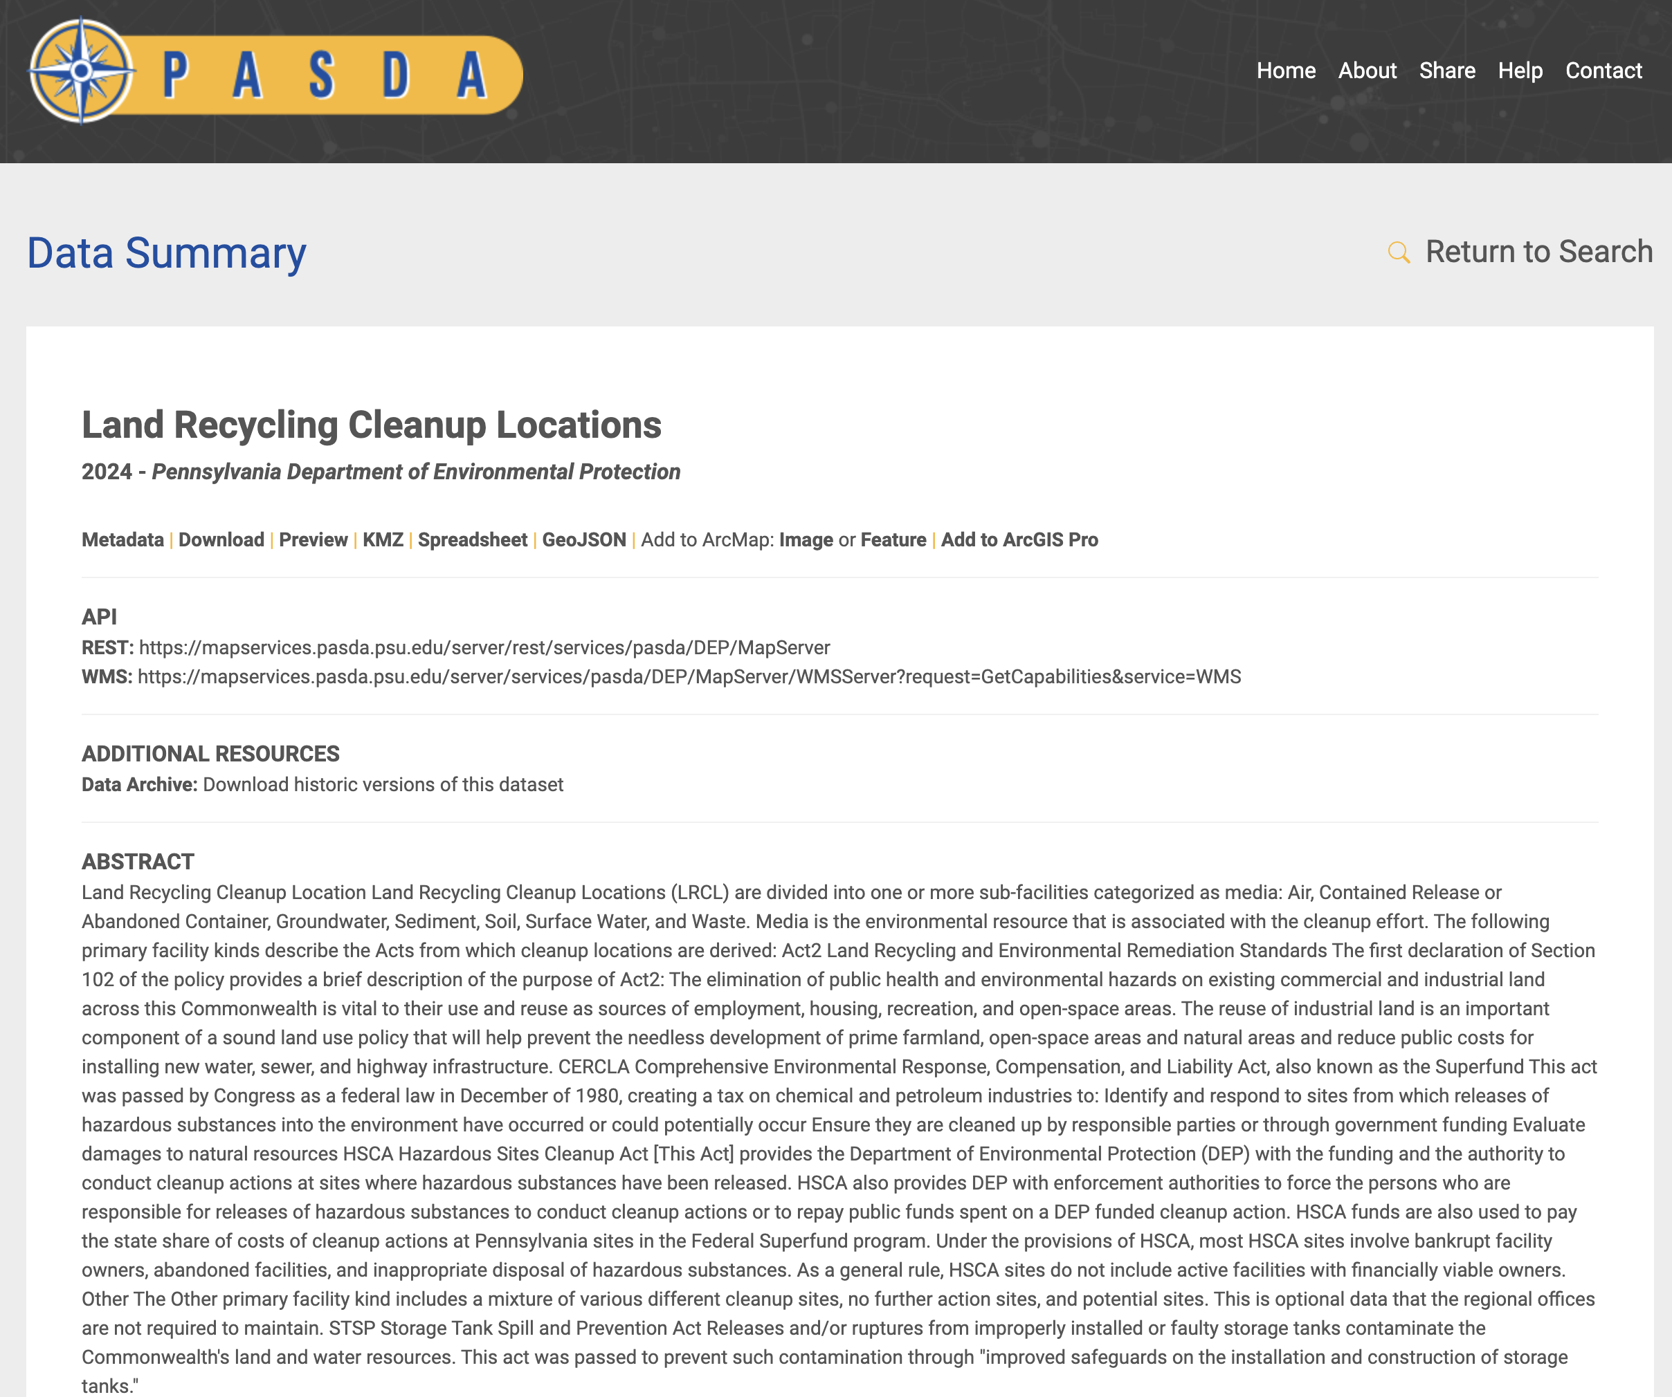
Metadata Best Practices

Slide 46
Metadata Best Practices
Define/describe attributes:
For your own needs and for the users, this is one of the most important things you can do!
You will spend less time answering questions and you will help the people who come after you.

Slide 47
Metadata Best Practices
Attribute:
Attribute_Label:SOTHER_FID
Attribute:
Attribute_Label:COMPLIANCE
Attribute:
Attribute_Label:PRIMARY__1
Attribute:
Attribute_Label:SUB_FACILI

Slide 48
Metadata Best Practices
Create a data dictionary.
This will serve you well for years to come!

Slide 49
Metadata Best Practices
Include as much information as you have time for!
Things like Progress (under the Data Identification section in the FGDC and ISO standard) and Completeness Report (under the Data Quality section in the standards) really help.
For example, should the user expect this data to be updated regularly or is it complete as is?

Slide 50
Metadata Best Practices
Consider use constraints and access constraints and distribution liability.
PASDA has a boilerplate use constraint blurb we use.

Slide 51
Metadata Mistakes

Slide 52
Metadata Mistakes
Defining data too broadly or finely.
Not completing entity and attribute section fully.
Using a broad title that doesn’t clearly identify what the data is.
Not including methodology (where applicable).
Ignoring that people need to know when data was last updated rather than refreshed. What is reflected in your metadata?
The Curse of Knowledge

Slide 53
Biggest Metadata Mistake
Not
Creating
Metadata!

Slide 54
Metadata for PASDA

Slide 55
What Metadata Do You Need to Share with PASDA?
We just need title, abstract, and some of the basic fields completed.
If you have questions, just ask us and we can help you!

Slide 56
Questions, Comments, Discussion

Slide 57
Thank you!

Slide 58
Additional Resources
https://mediaspace.esri.com/media/t/1_1zbo2s0k
https://pro.arcgis.com/en/pro-app/3.1/help/metadata/view-and-edit-metadata.htm#ESRI_SECTION1_758736AA33AE4F2EA800839DF3C091E7
https://www.esri.com/arcgis-blog/products/arcgis-online/announcements/introducing-metadata-editor-beta/
https://www.youtube.com/watch?v=idBJ4HPjhh4
https://enterprise.arcgis.com/en/portal/latest/use/metadata.htm
https://doc.arcgis.com/en/arcgis-online/manage-data/metadata.htm

